Slide 1

Week 7 Scribe Notes

Slide 2
Uncertainty Bias
What is it?
One group is under-represented in the sample, therefore there is more uncertainty associated with predictions about that group
The algorithm is risk averse, so with other conditions remaining the same, it will prefer to make decisions based on predictions about which they are more confident

Slide 3
GDPR (General Data Protection Rule)
What is it?- Legal framework that sets guidelines for processing and collection of information from individuals living in the European Union
Went into effect in April 2018, replacing previous 1995 EU Data Protection Directive
Carries large penalties (20M euros or 4% global revenue) for violation as it is law, rather than a directive.
Article 22 – Prohibits any automated decision making unless conditions are met
Claims algorithmic profiling is discriminatory
Paragraph 71 – specifically addresses discrimination from profiling that makes use of sensitive data
Article 13 - Data subjects have a right to access information collected about them
Article 14 - Subjects should be notified of data being collected

Slide 4
Interpretations of GDPR Article 22 Paragraph 71
Two interpretations - There exist two ways of viewing this section of GDPR and how it pertains to identifying/discriminatory features
Minimal Interpretation – Just get rid of protected features
Pros: Simple to implement
Cons: Does not address correlations between protected and unprotected features
Maximal Interpretation - Get rid of all features that might be correlated with protected features
Pros: You have a legal model
Cons: You might lose predictive accuracy
Cons: You might run into the problem of uncertainty bias
Uncertainty bias
One group is underrepresented in the sample, so there is more uncertainty associated with predictions about that group
Algorithm is risk-averse, so will prefer to make decisions from higher confidence decisions

Slide 5
Critical Analysis of Post-Hoc Interpretable ML Models
Post-hoc general characteristics
Treat ML model as a black box
Design a system to explain what the black box learned/decided
Partial Dependence Plot (PDP)
Pick a feature, vary the feature values across the data set
Observe how predictive accuracy changes as the values are varied
Pros: Easy to implement; intuitive
Cons: Assumption of independence; does not show changes at individual points in the data set
Individual Conditional Expectation (ICE)
Instead of looking at the data set average, this looks at individual data points
Each line in the model's graph measures how changing a feature value affects a single data point
Pros: Easy to implement; intuitive
Cons: Assumption of independence

Slide 6
Critical Analysis of Post-Hoc Interpretable ML Models (cont.)
Permutated Feature Importance
Shows the "feature importance" measuring how a single feature can affect the dataset
Pros:
Provides global insight
Comparable across platforms
Cons:
Assumption of independence
Global Surrogate
Trains black box model to make a prediction
Train an interpretable model on the predictions from the black box model
Pros:
Any interpretable model can be used
Decision Tree, Linear model, etc
Cons:
Can only explain the model, not the data
Surrogates might not be accurate

Slide 7
Critical Analysis of Post-Hoc Interpretable ML Models (cont.)
Local Surrogate
A model which mimics decision of a complicated model for one specific region of data
Will not be effective for all regions of the data, only one
LIME
Generates a dataset of perturbed instances by turning some of the interpretable components “off”
Perturbed instances are close to the original image, so they lie in the vicinity of the original data point
For each perturbed instance, one can use the complicated un-interpretable trained model to get the probability that a tree frog is in the model
Pros:
Model-agnostic
Human-friendly explanations
Cons:
Need to define a kernel to define the area in which data points are considered
Often open problem, no good solution

Slide 8
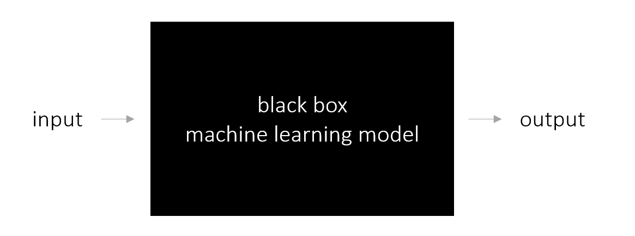
Lime Model

Slide 9
Critical Analysis of Post-Hoc Interpretable ML Models (cont.)
SHAP (Shapley Value)
Prediction can be explained by assuming that each feature value of the instance is a player in a game
Differs from surrogates because it is not learning a new ML model
Contribution from each player is measured by adding and removing the player from all subsets of the rest of the players
The Shapley value for one player is the weighted sum of all its contributions
Current state-of-the-art, should be used today
Cons:
Very complex, computationally expensive

Slide 10
Intrinsically Interpretable Models
Decision Trees
Classification Rules
Pros
Graphical Structure
Work with a subset of attributes
Hierarchical representation dictates the order features are considered in
Cons
Irrelevant attribute splits
Data Fragmentation due to irrelevant splits
List of if-then-else logical statements*
Pros
More interpretable
Easier to understand modular pieces
Enable aggressive pruning/limit number of conditions that are present inside these rules
Irrelevant splits can be removed
Cons:
No ordering of clauses, how to figure out which ones are more important?
How to measure feature importance? Average number of rule conditions tested

Slide 11
Intrinsically Interpretable Models
Decision Tables
Nearest-Neighbors
Bayesian Network Classifiers
Tabular representation of data*
Pros
Fairly interpretable
Legitimately a table
Cons
Size of these tables can grow prohibitively long
For any data point, look at nearby data points, whichever data point has majority, then the selected data point will match*
Pros
Can be improved using prototype points
Single points representing one class category
Cons:
Explanation is different for every data point
Each data point has a different set of nearest neighbors
How to improve?
Don't use model size as a single measure of interpretability
Introduce semantic monotonicity constraints in model building
Probability of someone having cancer is going to go up as the age of a person goes up

